Slide 1
Purging UI Layer
UI Mock Up Presentation
Yash Sharma
SE Intern

Slide 2
COMPONENTS
Login
Request Process
Query Validation Process
Approval Process
Execution/Monitoring

Slide 3
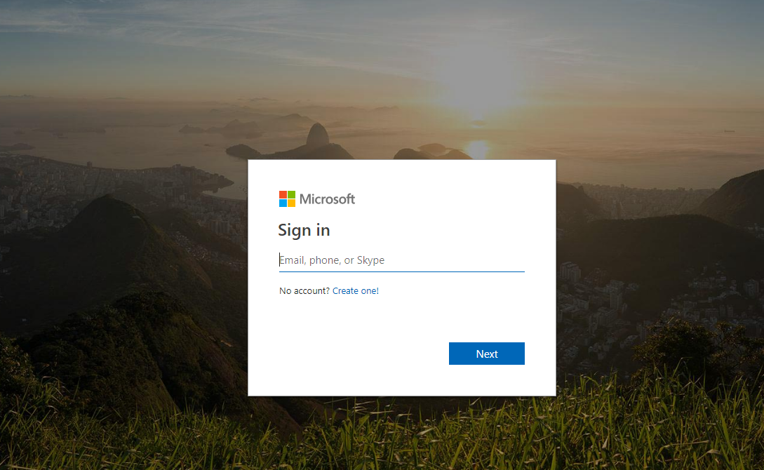
1. LOGIN
4
Notes:
*The Numbers written next to a button represents the slide number we would reach on clicking of that button*

Slide 4




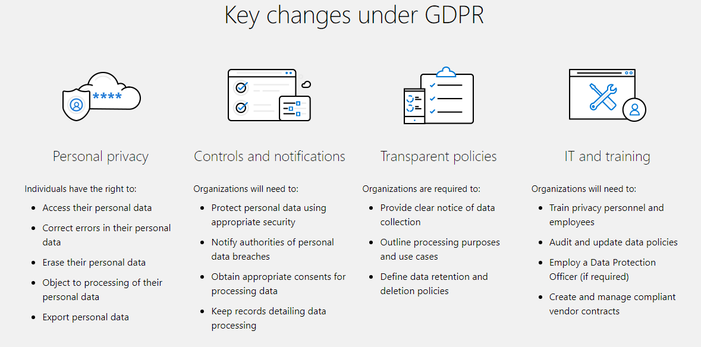
Homepage
GDPR LIFECYCLE
Home
My Requests
My Approvals
Deploy & Monitoring
Introduction about GDPR
5
Register >
8
Modify >
Notes:
ADD page numbers

Slide 5

Register
-> Details of Server/DS
GDPR LIFECYCLE
Add Server
OEMDM1
Data Source Name
Server Instance/Name
IMA1018YASH
6
Next >

Slide 6


Register
-> Add Users
GDPR LIFECYCLE
Add User
ALIAS :
Enter Username of emp here
S.No | Username | Read | Write | Admin | Remove
1 | T-yashar
2 | T-arugup
3 | potari
4 | modurais
5
< Prev
7
Next >

Slide 7
Register
-> Summary
GDPR LIFECYCLE
Summary
Sno. | DS Name | Server Name | Users’ Name | Permissions
1 | OEMDM1 | IMA1018YASH | T-yashar T-arugup Potari Modurais | Read, Write Read Read Read, write, admin
6
Add More
6
4
4
< Prev
Register
Cancel
Notes:
Change table

Slide 8
Modification
-> Select the Server
GDPR LIFECYCLE
Modification of DS
S.No | DS Name | Server Name | Operations
1 | OEMCOR | IMA10Y
2 | OEMOM1 | IMA@Z
3 | CPR2 | IMS12Y
9
Add
Delete
Update
Add
Delete
Update
Add
Delete
Update
Notes:
DS data source
(Display only those servers to which the user have access)

Slide 9


Purge
-> Select Tables
GDPR LIFECYCLE
Select DB from <Selected server’s Name>
Dropdown list of DBs
Select Tables
Search for tables here
TB1
TB2
TB3
Remove button with every option in the above list.
8
< Prev
Next >
10
Notes:
Initially the select tables section would be blank, once DB is selected then list would appear

Slide 10
Purge
-> Data/Query purging
GDPR LIFECYCLE
Purging Details <DB Name>
Sample Text
N | Table Name | Type of Purging Select All Select All
1 | TB1 | Date | Query
2 | TB2 | Date | Query
3 | TB3 | Date | Query
< Prev
Next >

Slide 11
Purge
-> Data/Query purging
GDPR LIFECYCLE
Purging Details <DB Name>
TB1
N | Table Name | Type of Purging Select All Select All
1 | TB1 | Date | Query
2 | TB2 | Date | Query
3 | TB3 | Date | Query
Date Column
Purge Key
Purge Table
No. of years
Save
< Prev
Next >
Notes:
Save and Validate buttons when clicked can show the message that the data has been saved successfully.

Slide 12
Purge
-> Data/Query purging
GDPR LIFECYCLE
Purging Details <DB Name>
TB2
Purge Select Query
N | Table Name | Type of Purging Select All Select All
1 | TB1 | Date | Query
2 | TB2 | Date | Query
3 | TB3 | Date | Query
Validate
Purge Delete Query
Validate
Save
< Prev
Next >
Notes:
Select all date and all queiries

Slide 13
Purging
-> Summary and approval request
GDPR LIFECYCLE
Summary and approval request
Request ID | DS Name | DB Name | Tables Name | Query
1 | OEMCOR1 | DBS1 DBS2 | TB1 TB2 | SELECT *FROM EMP….. SELECT * FROM……
8
Add More
< Prev
14 Request for approval
4 Cancel
Notes:
Add more button redirects to DB selection
Add database name column

Slide 14
My request
(new page)
GDPR LIFECYCLE
Home
My Requests
My Approvals
My Approvals
Deploy & Monitoring
Home
My Requests
Deploy & Monitoring
My requests
Req ID | DS Name | DB Name | Tables Name | Query | Status
1 | OEMCOR | DBS1 | TB1 | Select* FROM…… | Approved
 |  | DBS2 | TB2 | Select# FROM…
2 | OEMOM1 | DBS3 | TB3 | Select * FROM….. | Pending…
3 | OEMOM1 | DBS7 | TB1 | SELECT * FROM…… | Rejected
16 DEPLOY
Notes:
Deploy would take the user to Monitoring page!
If it fails probably we can see the suggestions from the approvers

Slide 15
My approvals
(new page)
GDPR LIFECYCLE
Home
My Requests
My Approvals
My Approvals
Deploy & Monitoring
Home
My Requests
Deploy & Monitoring
My approvals
Pending
Req ID | DS Name | DB Name | Tables Name | Query | Options
1 | OEMCOR | DBS1 | TB1 | Select* FROM……
 |  | DBS2 | TB2 | Select* from …
2 | OEMOM1 | DBS1 | TB3 | Select * FROM…..
3 | OEMOM1 | DBS5 | TB3 | SELECT * FROM……
Accept
Reject
Accept
Reject
Accept
Reject
History
Req ID | DS Name | DB Name | Tables Name | Query | Options
1 | OEMCOR | DBS7 | TB1 | Select* FROM…… | Rejected
 |  | DBS4 | TB2 | Select* from …
2 | OEMOM1 | DBS6 | TB3 | Select * FROM….. | Approved
3 | OEMOM1 | DBS9 | TB3 | SELECT * FROM…… | Rejected
Notes:
Add DB name on every page

Slide 16
Deploy & Monitoring
(new page)
GDPR LIFECYCLE
Home
My Requests
My Approvals
My Approvals
Deploy & Monitoring
Home
My Requests
Deploy & Monitoring
Deploy and Monitoring
Name | Enabled | Status | Scheduled | Last Run
Job 1 | No | Idle | Yes | Never
Job2 | Yes | Running | Yes | Never
Job3 | Yes | Succeeded | Yes | Never
Job4 | Yes | Failed | Yes | Never
Notes:
Status: running, idle, succeeded, failed

